Slide 1

Convolutional Neural Networks
More edge detection
deeplearning.ai

Slide 2

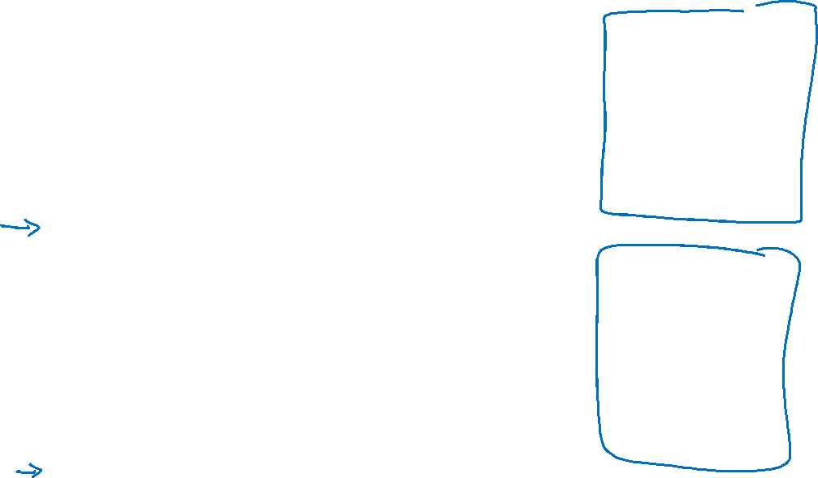


Vertical edge detection examples
10 | 10 | 10 | 0 | 0 | 0
10 | 10 | 10 | 0 | 0 | 0
10 | 10 | 10 | 0 | 0 | 0
10 | 10 | 10 | 0 | 0 | 0
10 | 10 | 10 | 0 | 0 | 0
10 | 10 | 10 | 0 | 0 | 0
0 | 30 | 30 | 0
0 | 30 | 30 | 0
0 | 30 | 30 | 0
0 | 30 | 30 | 0
1 | 0 | -1
1 | 0 | -1
1 | 0 | -1
$$∗$$
$$=$$
0 | 0 | 0 | 10 | 10 | 10
0 | 0 | 0 | 10 | 10 | 10
0 | 0 | 0 | 10 | 10 | 10
0 | 0 | 0 | 10 | 10 | 10
0 | 0 | 0 | 10 | 10 | 10
0 | 0 | 0 | 10 | 10 | 10
0 | -30 | -30 | 0
0 | -30 | -30 | 0
0 | -30 | -30 | 0
0 | -30 | -30 | 0
1 | 0 | -1
1 | 0 | -1
1 | 0 | -1
$$∗$$
$$=$$

Slide 3

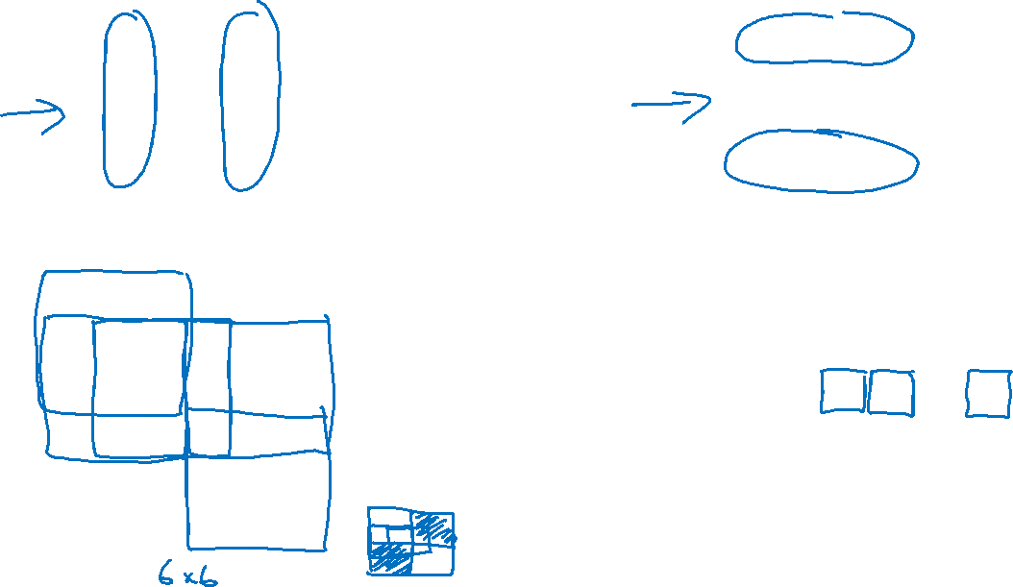
Vertical and Horizontal Edge Detection
1 | 0 | -1
1 | 0 | -1
1 | 0 | -1
1 | 1 | 1
0 | 0 | 0
-1 | -1 | -1
Vertical
Horizontal
10 | 10 | 10 | 0 | 0 | 0
10 | 10 | 10 | 0 | 0 | 0
10 | 10 | 10 | 0 | 0 | 0
0 | 0 | 0 | 10 | 10 | 10
0 | 0 | 0 | 10 | 10 | 10
0 | 0 | 0 | 10 | 10 | 10
0 | 0 | 0 | 0
30 | 10 | -10 | -30
30 | 10 | -10 | -30
0 | 0 | 0 | 0
1 | 1 | 1
0 | 0 | 0
-1 | -1 | -1
$$∗$$
$$=$$

Slide 4
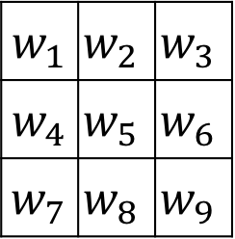
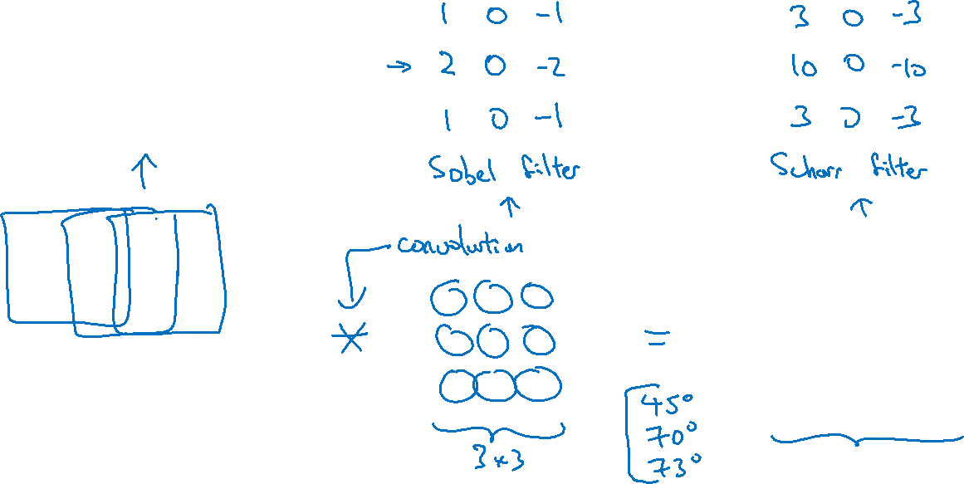
Learning to detect edges
1 | 0 | -1
1 | 0 | -1
1 | 0 | -1
3 | 0 | 1 | 2 | 7 | 4
1 | 5 | 8 | 9 | 3 | 1
2 | 7 | 2 | 5 | 1 | 3
0 | 1 | 3 | 1 | 7 | 8
4 | 2 | 1 | 6 | 2 | 8
2 | 4 | 5 | 2 | 3 | 9
$w_{1}$ | $$w_{2}$$ | $$w_{3}$$
$w_{4}$ | $$w_{5}$$ | $$w_{6}$$
$w_{7}$ | $$w_{8}$$ | $$w_{9}$$

